Slide 1
Fallout from Russia’s invasion of Ukraine: impact on Credendo cover policy
Pascaline della Faille
02/06/2022

Slide 2
Fallout from war in Ukraine
Regional impacts
Even if Russia and Ukraine represent a small share of global output, sharp economic downturn (-8.5% in Russia and -35% in Ukraine in 2022 ) has global impact
Trade: sharp contraction of Russian and Ukraine imports
Tourism: sharp decrease in tourist arrivals from Russia and Ukraine. (Turkey, Egypt, Georgia Montenegro, Bulgaria)

Slide 3
Fallout from war in Ukraine
Regional impacts
Remittances coming from Russia: some countries of CIS region are largely reliant on remittances coming from Russia.
The displacement of Ukrainian people to neighbouring countries (Poland, Moldova, Cuba Romania, Hungary, Slovakia)

Slide 4
Fallout from war in Ukraine
Global financial conditions
Monetary tightening amid high inflation
Increase in risk aversion
Limited financial contagion so far
Flight to quality flows
Main risks:
Large capital outflow out of EMs (cf. impact on exchange rate and/or FX reserves)
Higher borrowing costs for corporates and sovereign issuers
More difficult access to financial markets

Slide 5
Fallout from war in Ukraine
Commodity prices
Sharp increase in energy prices and to a lesser extent metal and agriculture prices
Large negative impact on commodity importers
Additional increase in inflation
Heightened risk of social unrest
Additional burden on public finances
However positive impact on commodity exporters

Slide 6
Fallout from war in Ukraine
Global economic activity
After strong recovery in 2021, short term indicators indicated that global activity has slowed
Renewed supply chain disruptions amid war in Ukraine and zero-Covid policy in China
Expected slowdown in global trade

Slide 7
Fallout from war in Ukraine
Main risks
Russia’s invasion of Ukraine is a large negative shock in a difficult period (incomplete recovery, large public and private debt, weak economic fundamentals)
Rising inflation is a source of concern
Combination of high financial vulnerabilities and tightening of the global financial conditions
Impacts of climate change are becoming more and more visible (e.g. extreme weather events, energy transaction) …and fallouts are likely to increase (migration, social unrest, production disruptions, etc..)
Large social, trade and geopolitical tensions : rules-based framework that has governed international and economic relations since WWII under heavy challenges

Slide 8
Country risk evolution
Business environment: still positive trend

Slide 9
Country risk evolution
negative trend
Ukraine
Georgia
Belarus
Mali
Moldova
Russia
Antigua and Barbuda
Jamaica
Mexico
Ecuador
Oman
Trinidad and Tobago
Zambia
PAE: Political and Assimilated Events

Slide 10
Country risk evolution
Negative trend
Belarus
Russia
Ukraine
Sri Lanka
Brazil
Guyana
Oman

Slide 11
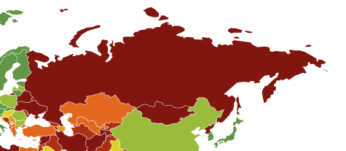
Credendo ST and MLT cover policy
Russia
EU sanctions: it is prohibited to provide public financing or financial assistance for trade with, or investment in, Russia with some exceptions
Despite exceptions, Credendo does not cover new transactions on Russia:
Western sanctions and Russian counter-sanctions
Risk of further tightening of sanctions and counter sanctions
Sharp deterioration of economic conditions
Credendo MLT political risk

Slide 12
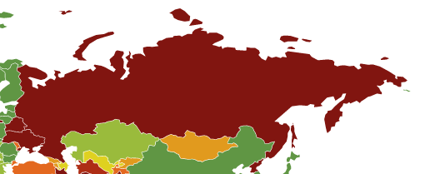
Credendo ST and MLT cover policy
Belarus and Ukraine
Belarus:
Western sanctions (targeting key products and banks)
Risk of further tightening of sanctions and counter sanctions
Sharp deterioration of economic conditions
Ukraine:
Martial law: moratorium on cross-border foreign currency payments" except where the central bank issues permits or where the companies concerned are doing essential or government work
Ongoing war
Credendo ST political risk

Slide 13
Contact details
Pascaline della Faille
Country and sector risk manager
T.: +32 (0)2 788 86 75
M: +32 (0)485 65 13 94
E.: p.dellaFaille@credendo.com
Mireille Janssens
Business Development Specialist
T: +32 (0)2 788 87 76
M: +32 (0)496 40 54 80
E.: m.janssens@credendo.com
Wim Bosman
Business Development Specialist
T: +32 (0)2 788 89 37
M: +32 (0)478 631 030
E.: w.bosman@credendo.com
Gilles Coetsier
Business Development Specialist
T: +32 (0)2 788 87 75
M: +32 (0)473 484 253
E.: g.coetsier@credendo.com
Gert Lambrecht
Head of Business Development
T.: +32 (0)2 788 89 27
M: +32 (0)472 18 06 18
E.: g.lambrecht@credendo.com
www.credendo.com

